Slide 1
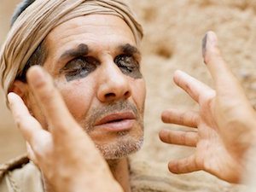
Seeing Jesus
John Chapter 9

Slide 2

Your past does NOT define you

Slide 3
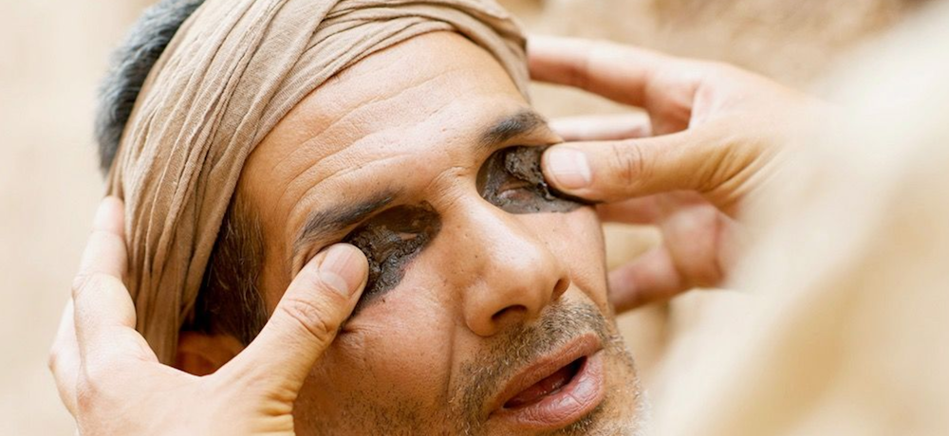
Let God be God

Slide 4


Slide 5


Slide 6
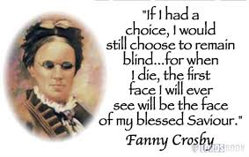

Slide 7


